Slide 2
Mission and Vision
First Science Park in the Baltics – operating since 1992.
Founders: University of Tartu, Institute of Physics, Estonian
University of Life Sciences, Tartu City and Tartu County.
Mission:
The mission of Tartu Science Park is to support the start-up, development and activities of science and technology intensive companies by offering business development services in Tartu Region.
Vision:
In 2013 Tartu Science Park is an international growth
center for R&D intensive companies and a driving force
of the regional innovation system.

Slide 3
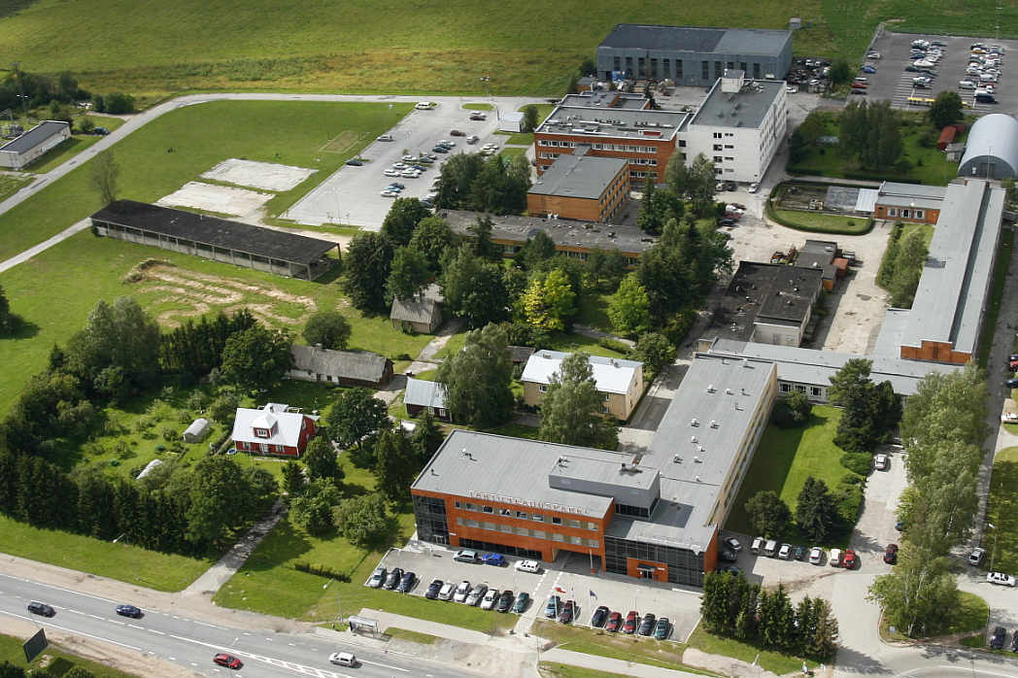
Premises

Slide 4
6 Goals to Achieve the Vision
Creating attractive business environment and infrastructure
Developing and enchancing incubation services for start-ups
Developing semi-industrial labs to support R&D in high-tech industries
Supporting cluster initiatives and international co-operation
Developing flexible financing schemes for start-ups
Developing human resources in an innovative and evolving organisation
Currently 65+ companies, including 14 incubation companies, over 300 persons employed
Main sectors: electronics and apparatus building, ICT, biotech, material technology, energy efficiency (in buildings)

Slide 5
Services
Rent and Infrastructure
Business Consultancy and Incubation
Established companies
Start-up and University spin-off companies
Technology Transfer and Promotion Activities
Networking and Cluster support activities

Slide 6
Examples of Clients

Slide 7
International Projects
Tartu Science Park has participated in 42 EU projects since 2004.
Over 7m EUR invested in and for the regional development.
Financed by:
European Regional Development Fund
European Commission
6th & 7th Framework Programme
Structural Funds
~1/3 infrastructure, ~2/3 competencies

Slide 8
CBC - Crossborder cooperation
Goal: Governmental bodies have clear understanding of the demand for their services in cross-border areas and they are obtaining the tool for utilizing modern ICT solutions. Furthermore, number of governmental electronic services are developed and piloted.
Target groups are:
local authorities;
professional ICT companies and organizations;
associations and unions of entrepreneurs;
The final beneficiaries are:
citizens of cooperating regions and other territories;
SMEs and larger companies and organisations;
local authorities of cooperating regions and other territories.
Find out more:
http://www.estlatrus.eu/eng/projects/764

Slide 9
Demo Centre
Established Democenter Network in:
Estonia (Tartu), Latvia (Ventspils and Riga),
Russia (St.Petersburg)
Both physical as well as virtual
Aimed for developers, companies and visitors
Focus in Tartu – mobile applications and location-based solutions
Find out more:
http://teaduspark.ee/democentre/

Slide 10
Semi-Industrial Laboratories
Semi-Industrial Laboratories
Protolab 2009
Nanolab 2011
Energylab 2013
Demo Centre 2012
Product Development Competence Center 2008

Slide 11
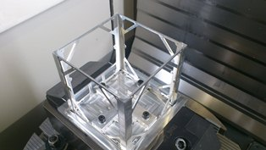
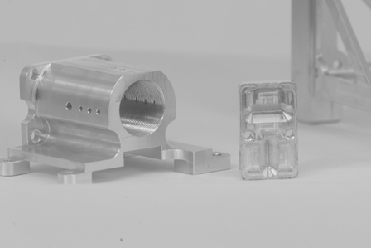
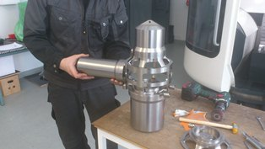
One-stop-shop for prototyping services!
Services for the mechatronics sector:
- product development consultation and prototyping services
organisation of CAD-CAM trainings
study trips and seminars
awareness raising and promotion activities

Slide 12
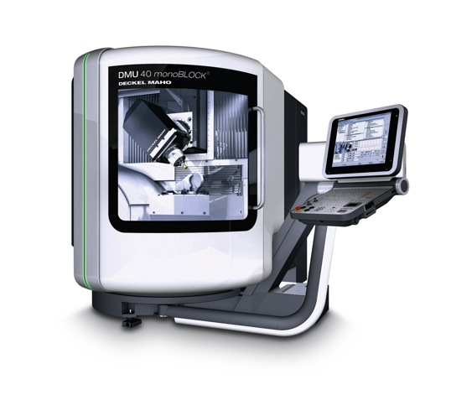
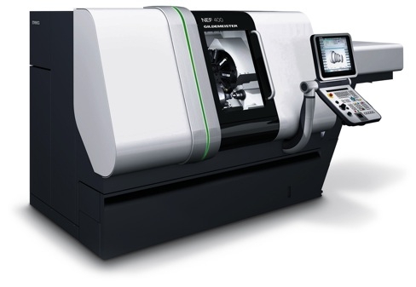
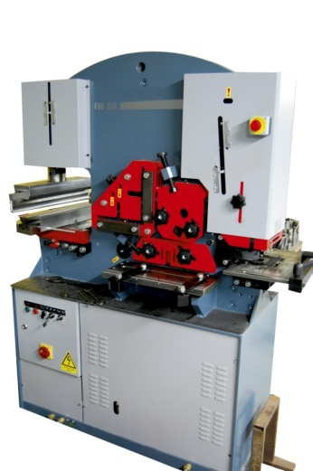
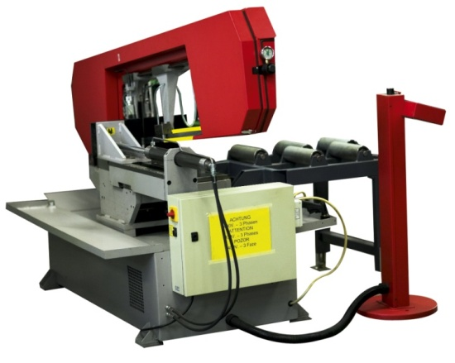
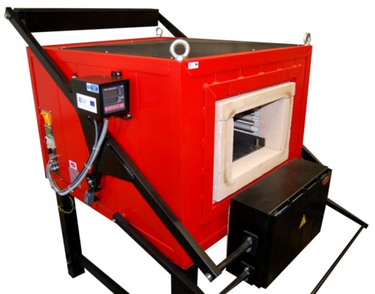
Equipment

Slide 13
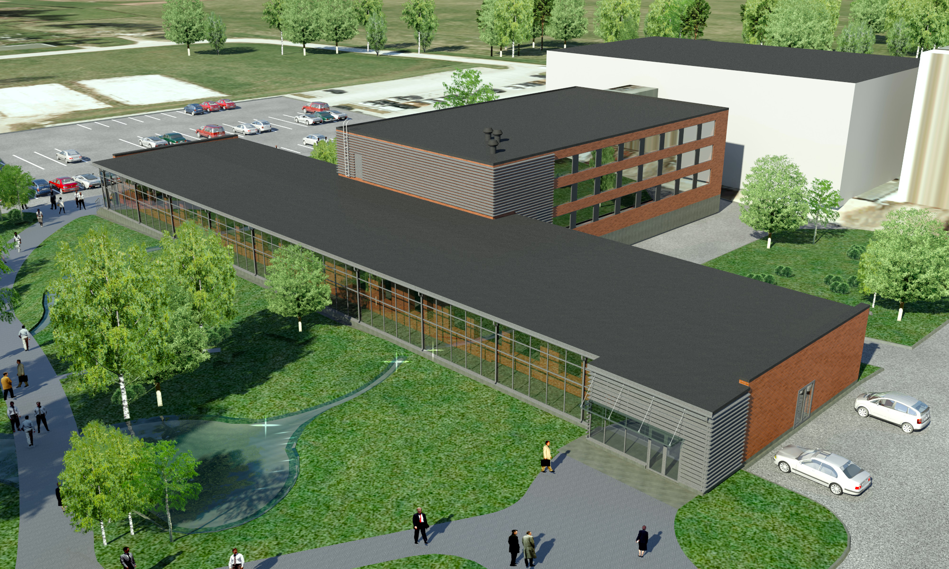
Nanolab

Slide 14
Nanolab
Nanolab Services
• Contract research and product development support services to companies engaged with nanotechnology-based product
development and introducing such products to mass production
• Metrology and testing services (e.g. for risk assessment) in the field of nanotechnology as required by standards and legal
acts
• Trainings to private sector companies to enhance the skills of
workforce and raise awareness about possibilities brought
along by new nanotechnologies.

Slide 15
Summary
Infrastructure (Business) Idea & Model
Prototyping
Financing
Sales & Marketing
Events & Networking

Slide 16
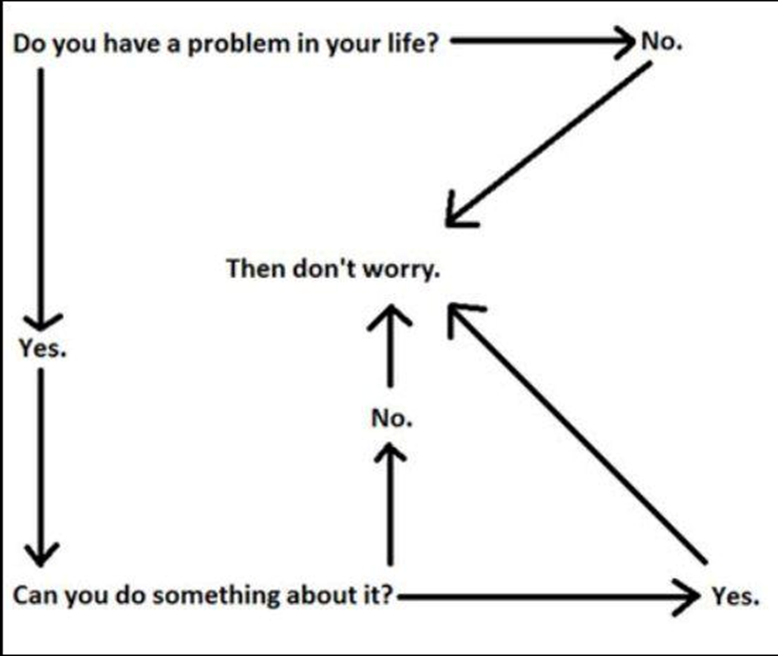
Thank you!
Vaido Mikheim
Project Manager
Tartu Science Park
vaido@sciencepark.ee
www.sciencepark.ee
www.facebook.ee/teaduspark

